Slide 1
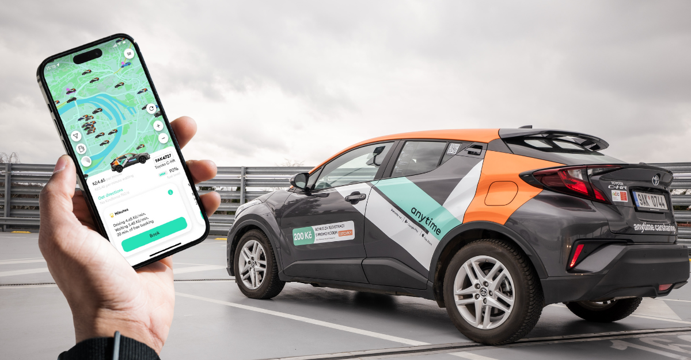
Car Sharing System
Cotos Ștefan

Slide 2
Software Architecture - Entities
User: Stores customer information
Personal details (name, phone number)
Authentication credentials
Driver's license information
Company Backend: Central system manager
Handles authentication and registration
Tracks car availability and state
Processes commands and rental operations
Phone Application: User interface for customers
Manages user interactions
Displays available cars
Provides car control interface
Car: Connected vehicle with controllable features
Unique identification (ID, VIN)
Location tracking
Current state (locked/unlocked, doors, lights, engine)

Slide 3
Software Architecture - Communication Protocol
REST API Architecture
JSON data format for requests/responses
Stateless communication between components
Authentication Endpoints:
/login: Validates user credentials
/register: Creates new user accounts
/check_license: Verifies driver's license status
Car Management Endpoints:
/cars: Lists available vehicles by location
/rent_car: Initiates vehicle rental
/stop_rent: Terminates rental agreement
Command Interface:
/send_command: Transmits actions to vehicles
/get_command: Vehicles poll for pending commands
/update_state & /get_state: Track vehicle conditions

Slide 4
Software Architecture - Use Case Flows
1. User Registration & Authentication
Account creation with driver's license validation
Secure login with credential verification
2. Vehicle Discovery & Rental
Location-based car search
Vehicle selection and reservation
Automated unlocking after rental approval
3. Vehicle Control & Monitoring
Remote door control (lock/unlock)
Light and engine management
Real-time state monitoring
4. Rental Termination & Payment
Pre-return vehicle state verification
Secure payment processing
Automated vehicle locking

Slide 5
Technologies Used
Backend Development:
Python 3.x
Flask web framework
SQLite database
Frontend Development:
Python Tkinter/ttkbootstrap (UI framework)
Request library for API communication
Vehicle Simulation:
Python script emulating car functionality
HTTP-based command processing
Communication:
RESTful API architecture
JSON data format
HTTP request/response protocol

Slide 6
Thank you!

